Slide 1
Lent Week 7 Presentation

Slide 2
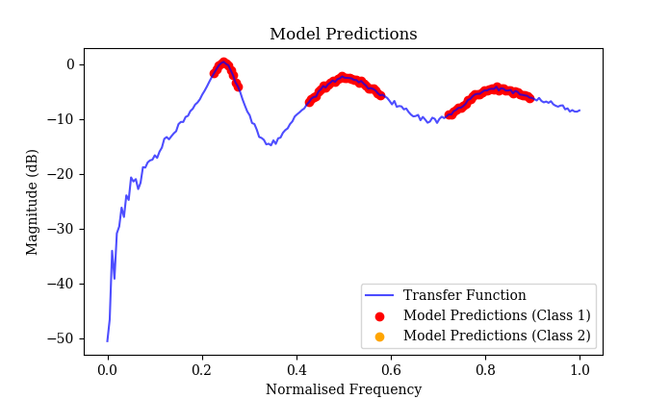
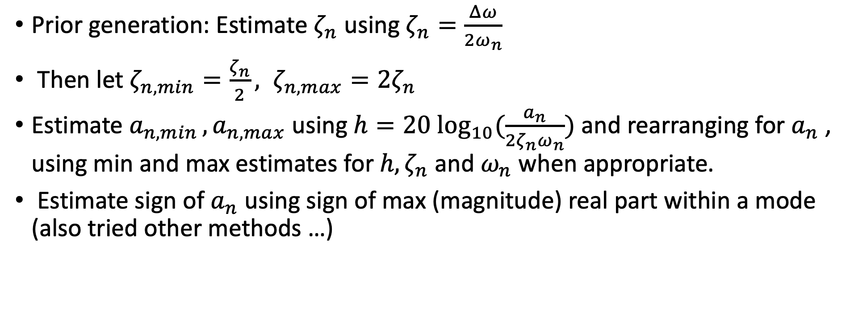
Sampling when generating priors using ML model
Prior generation: Estimate $ζ_{n}$ using $ζ_{n}=\frac{Δω}{2ω_{n}}$
Then let $ζ_{n,min}=\frac{ζ_{n}}{2}, ζ_{n,max}=2ζ_{n}$
Estimate $a_{n,min }, a_{n,max}$ using $h=20 \log_{10}(\frac{a_{n}}{2ζ_{n}ω_{n}})$ and rearranging for $a_{n}$ , using min and max estimates for $h, ζ_{n}$ and $ω_{n}$ when appropriate.
$⁡$Estimate sign of $a_{n}$ using sign of max (magnitude) real part within a mode (also tried other methods …)

Slide 3
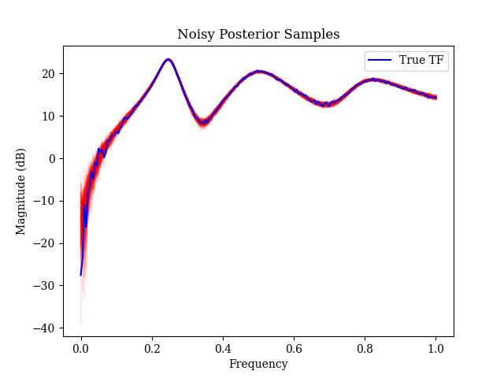
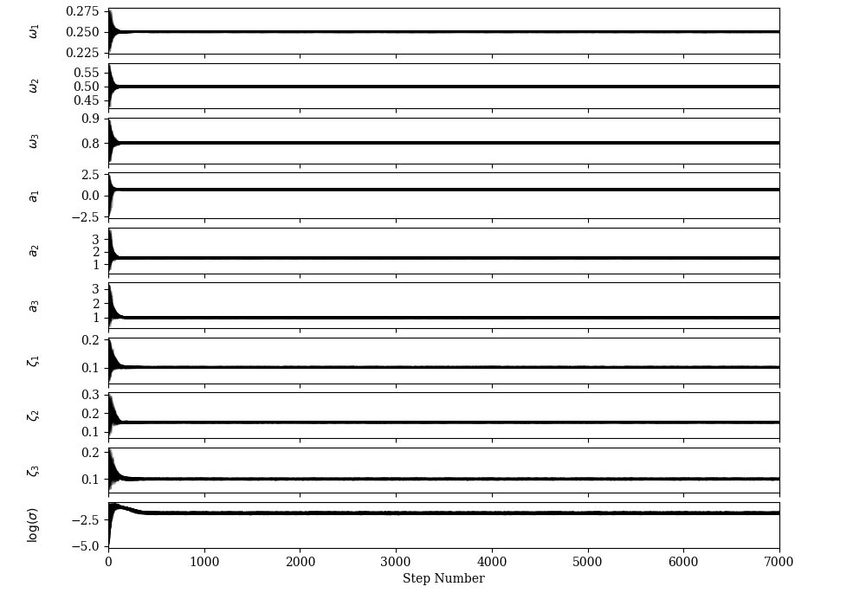
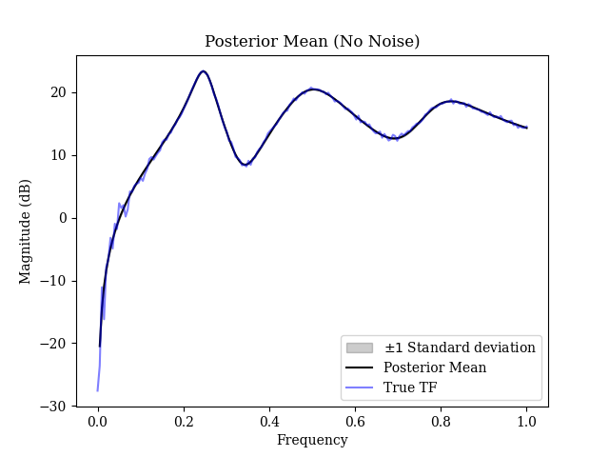
Fully automated
200 walkers, 7000 steps

Slide 4
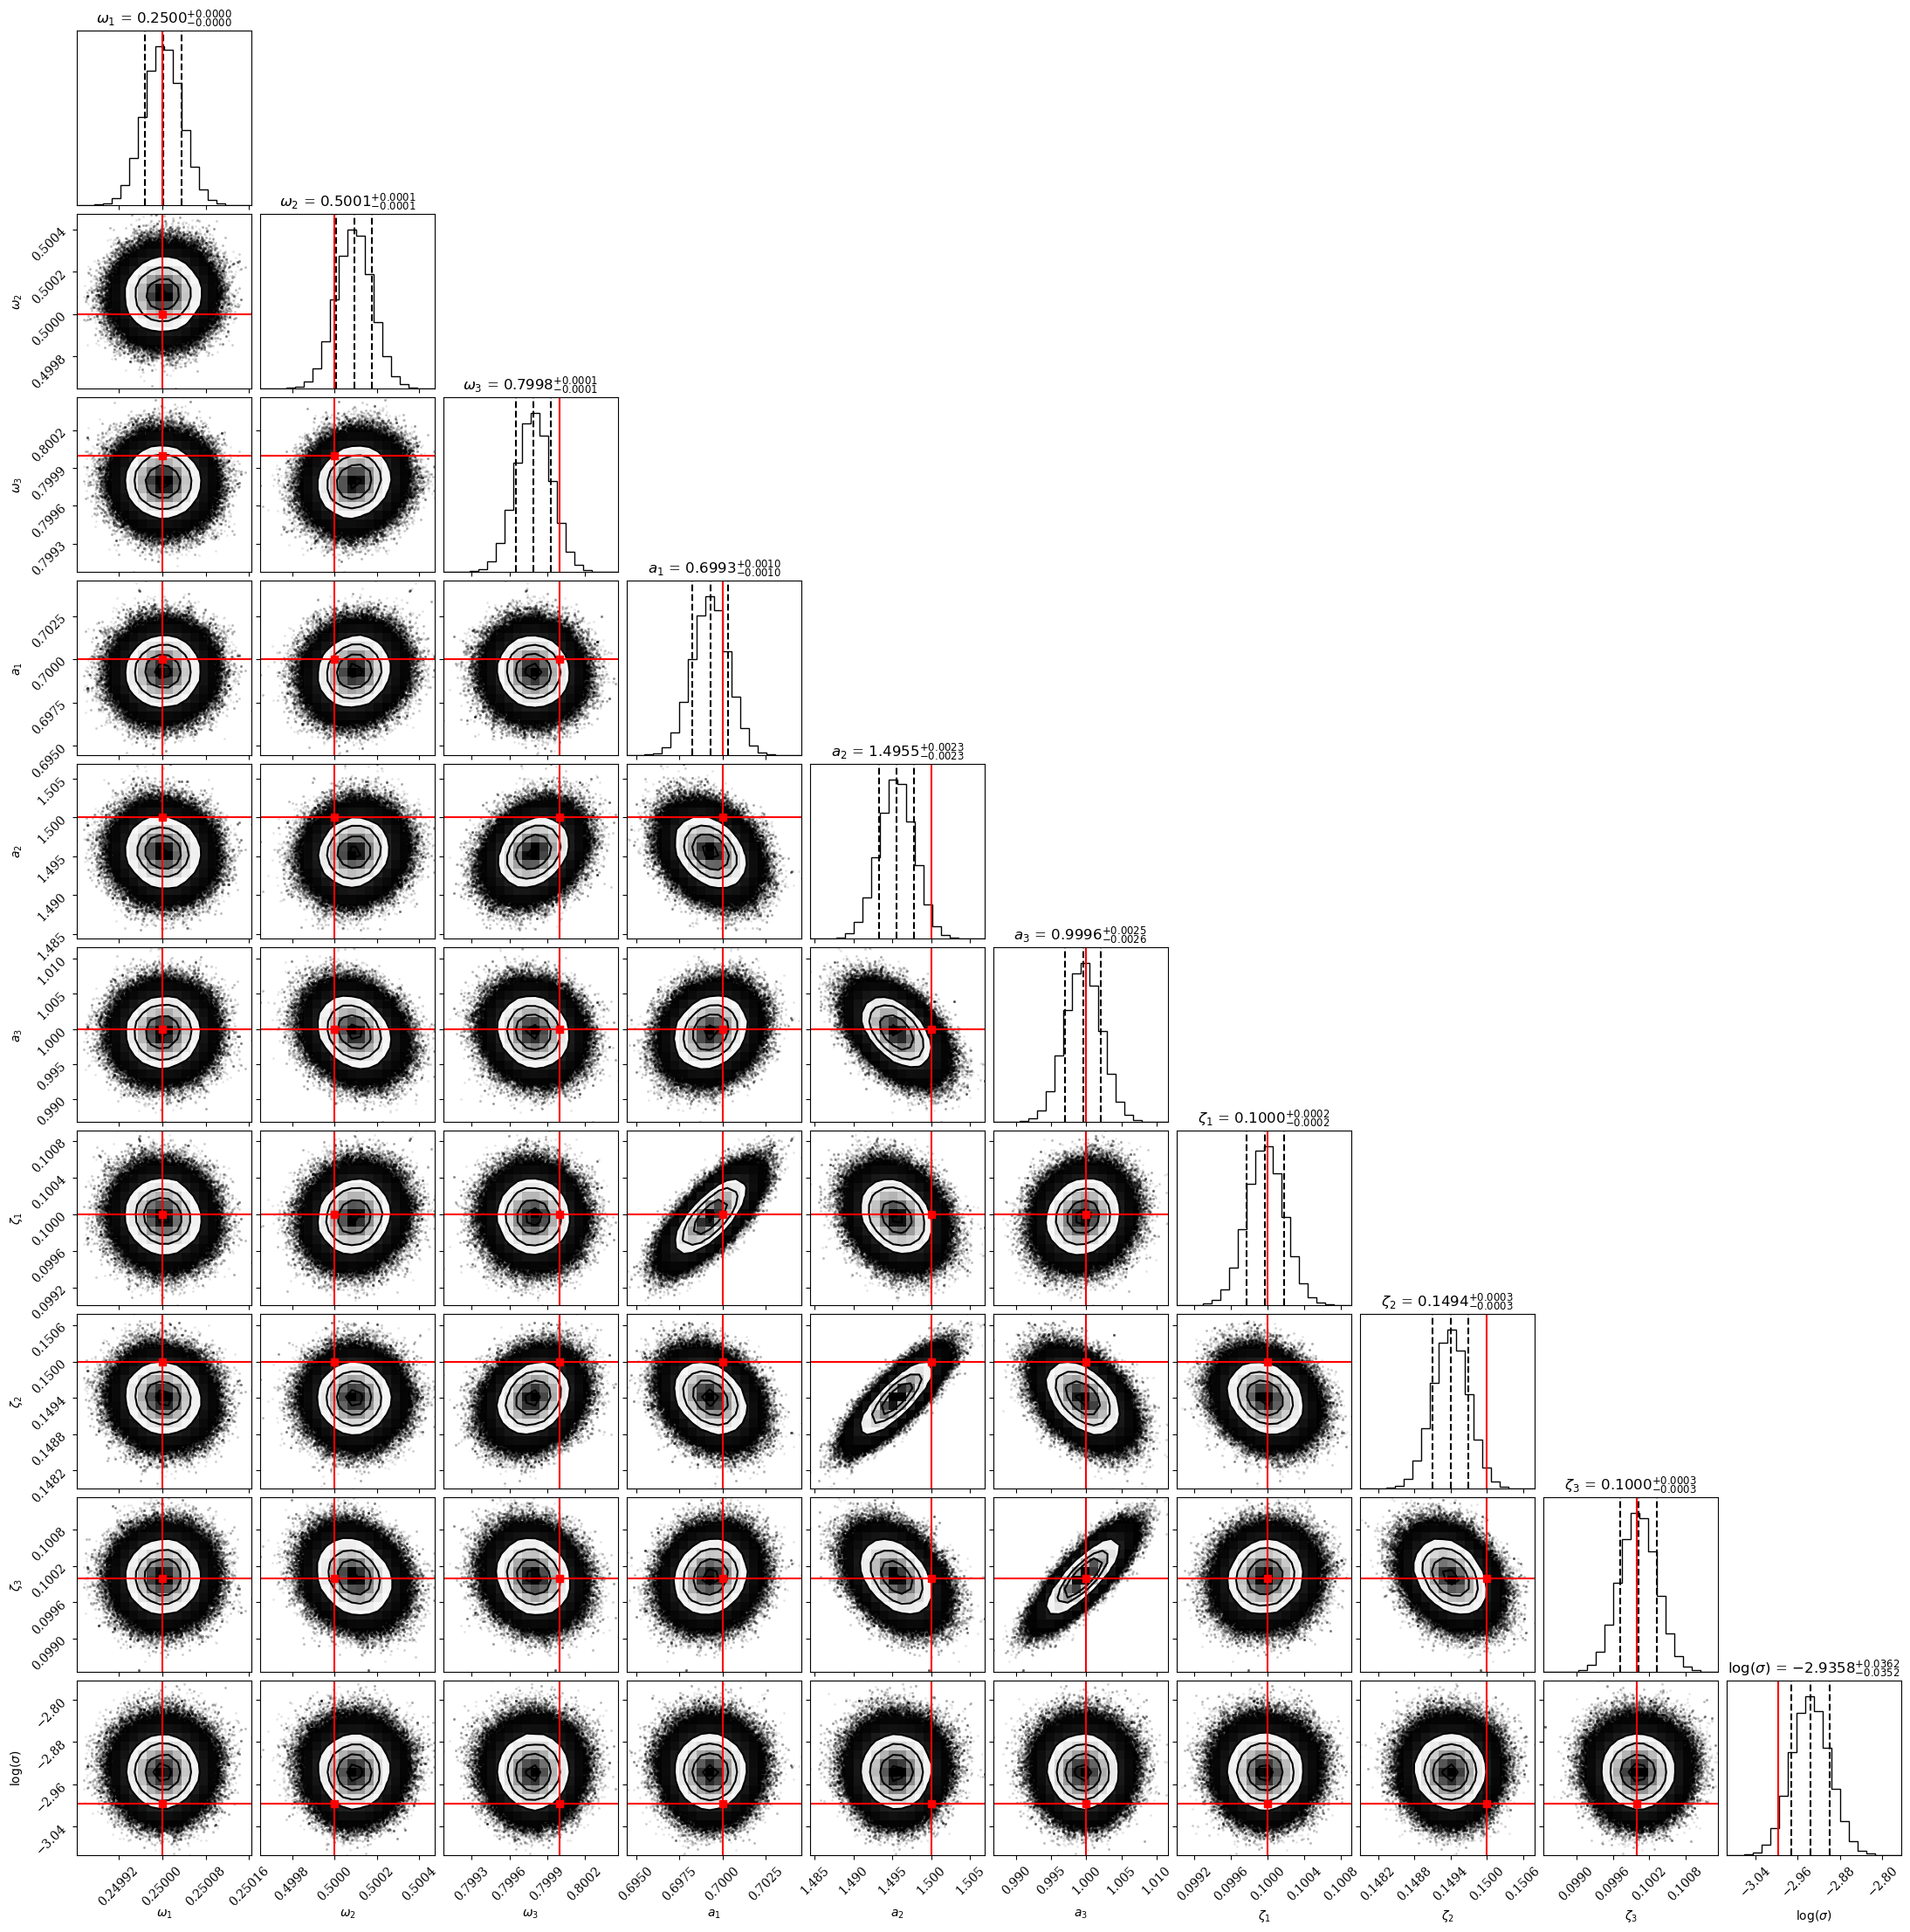

Slide 5
7000 samples, 200 walkers, previously taking 65 seconds
Acceptance fraction of 0.417
Rewrote / refactored code
Optimised modal sum, likelihood function and prior using Numba jit to improve sampling time to ~7 seconds

Slide 6
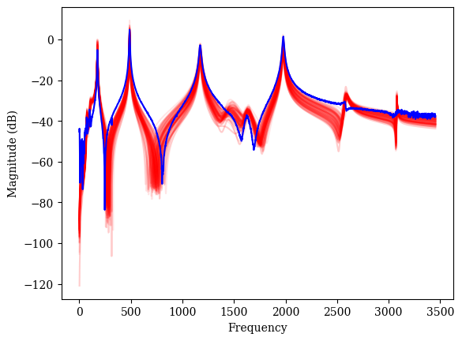
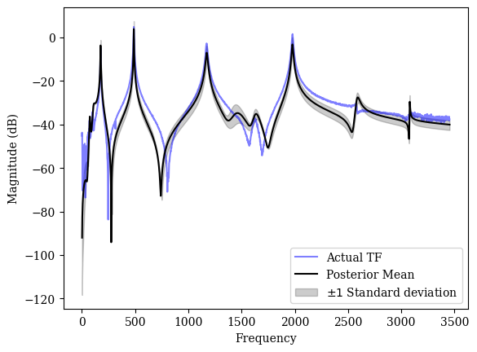

3C6
100 walkers, 150 iterations (not enough), takes approx. 20 mins (!)
Sign of $a_{n}$ for smaller modes is not correct
Posterior samples shown without noise (noise inference not good on this data)

Slide 7
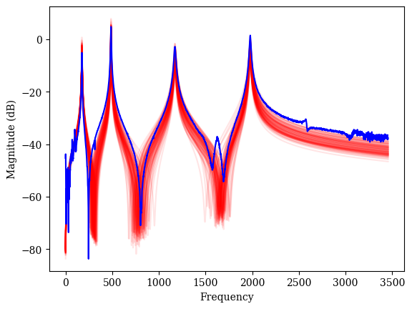
(Manually) only including 4 most prominent modes

Slide 8
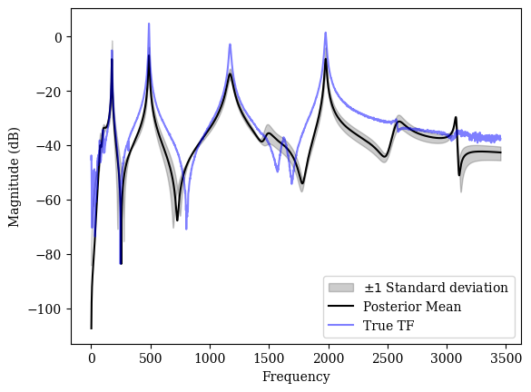
Tried many different ways of creating the priors (different widths etc.)
Too wide prior -> doesn’t converge well, too narrow -> doesn’t represent real system. Tricky to get prior correct
For convergence in high dimensions need to run for a long time
70 walkers, 2000 steps, 700 burn-in, run time: approx. 2 hours

Slide 9
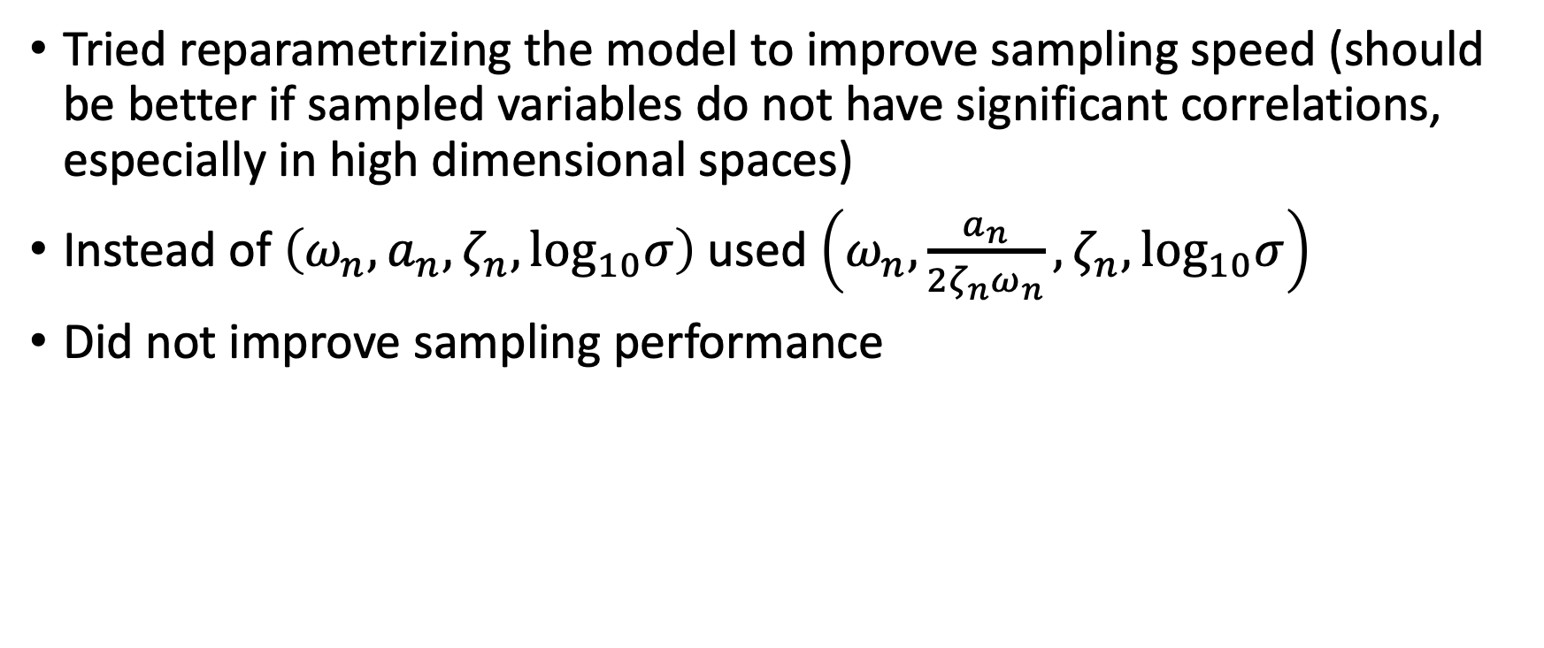
Tried reparametrizing the model to improve sampling speed (should be better if sampled variables do not have significant correlations, especially in high dimensional spaces)
Instead of $\left(ω_{n}, a_{n}, ζ_{n}, \log_{10}σ\right)⁡$used $\left(ω_{n},\frac{a_{n}}{2ζ_{n}ω_{n}}, ζ_{n}, \log_{10}σ\right)$
Did not improve sampling performance

Slide 10
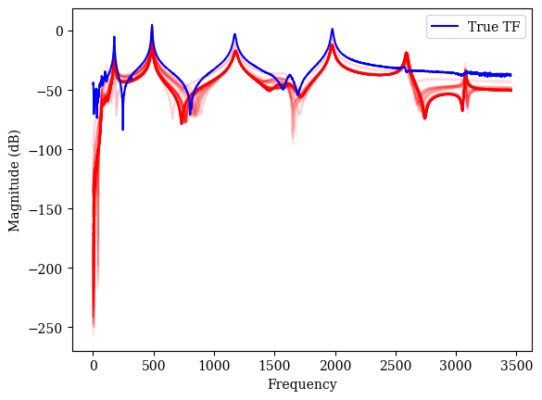
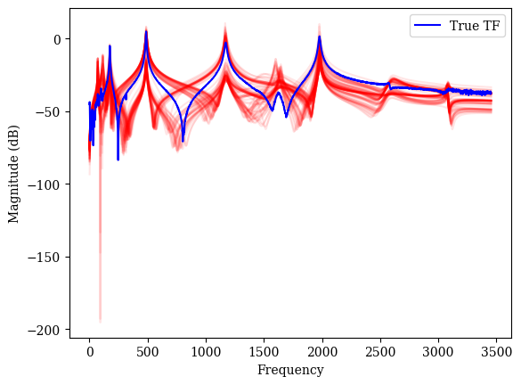
Changed likelihood function
Now matching TF magnitude as opposed to real and imaginary parts with noise added independently
Variable performance, doesn’t perform well on simpler TF
Though convergence is *much* faster

Slide 11
TODO
Calculate model evidence, include different modes and use to compare models (maybe based on estimated modal amplitudes / damping ratios – e.g. don’t include if low modal amplitude or v high damping)
Incorporate class 2 from model predictions into priors
Use different prior to uniform (gaussian etc.)
Try different samplers to try improve performance, or try different moves with EMCEE to see if they perform better

